Slide 1
Chapter 10: Evaluation and improvement of digital channel performance

Slide 2
Learning objectives
Understand the process, KPIs, and tools used to measure and improve digital marketing effectiveness
Understand the importance of content and site management for better customer experience
Notes:
Understand the process, KPIs and tools used to measure and improve digital marketing effectiveness
– Performance management for digital channels
• Review data within Google Analytics to identify performance and improvements
– Using Google Analytics to evaluate and improve digital marketing
• Identify the activities necessary when researching and managing digital activi- ties and content

Slide 3
Chapter content
Performance management for digital channels
Key elements in a Performance measurement system
Performance measurement process
The measurement framework t
Tools and techniques for collecting, analyzing, disseminating and actioning results.
Content management process
Responsibilities for customer experience and site management
Notes:
• What is it? A description of the digital media channel. • Advantages and disadvantages. A structured review of the benefits and drawbacks of • each channel.
Best practice in planning and management. A summary of the issues such as targeting, measurement and creative that need to be considered when running a campaign using each digital channel. This expands on the coverage given in the previous chapter on these issues.

Slide 4
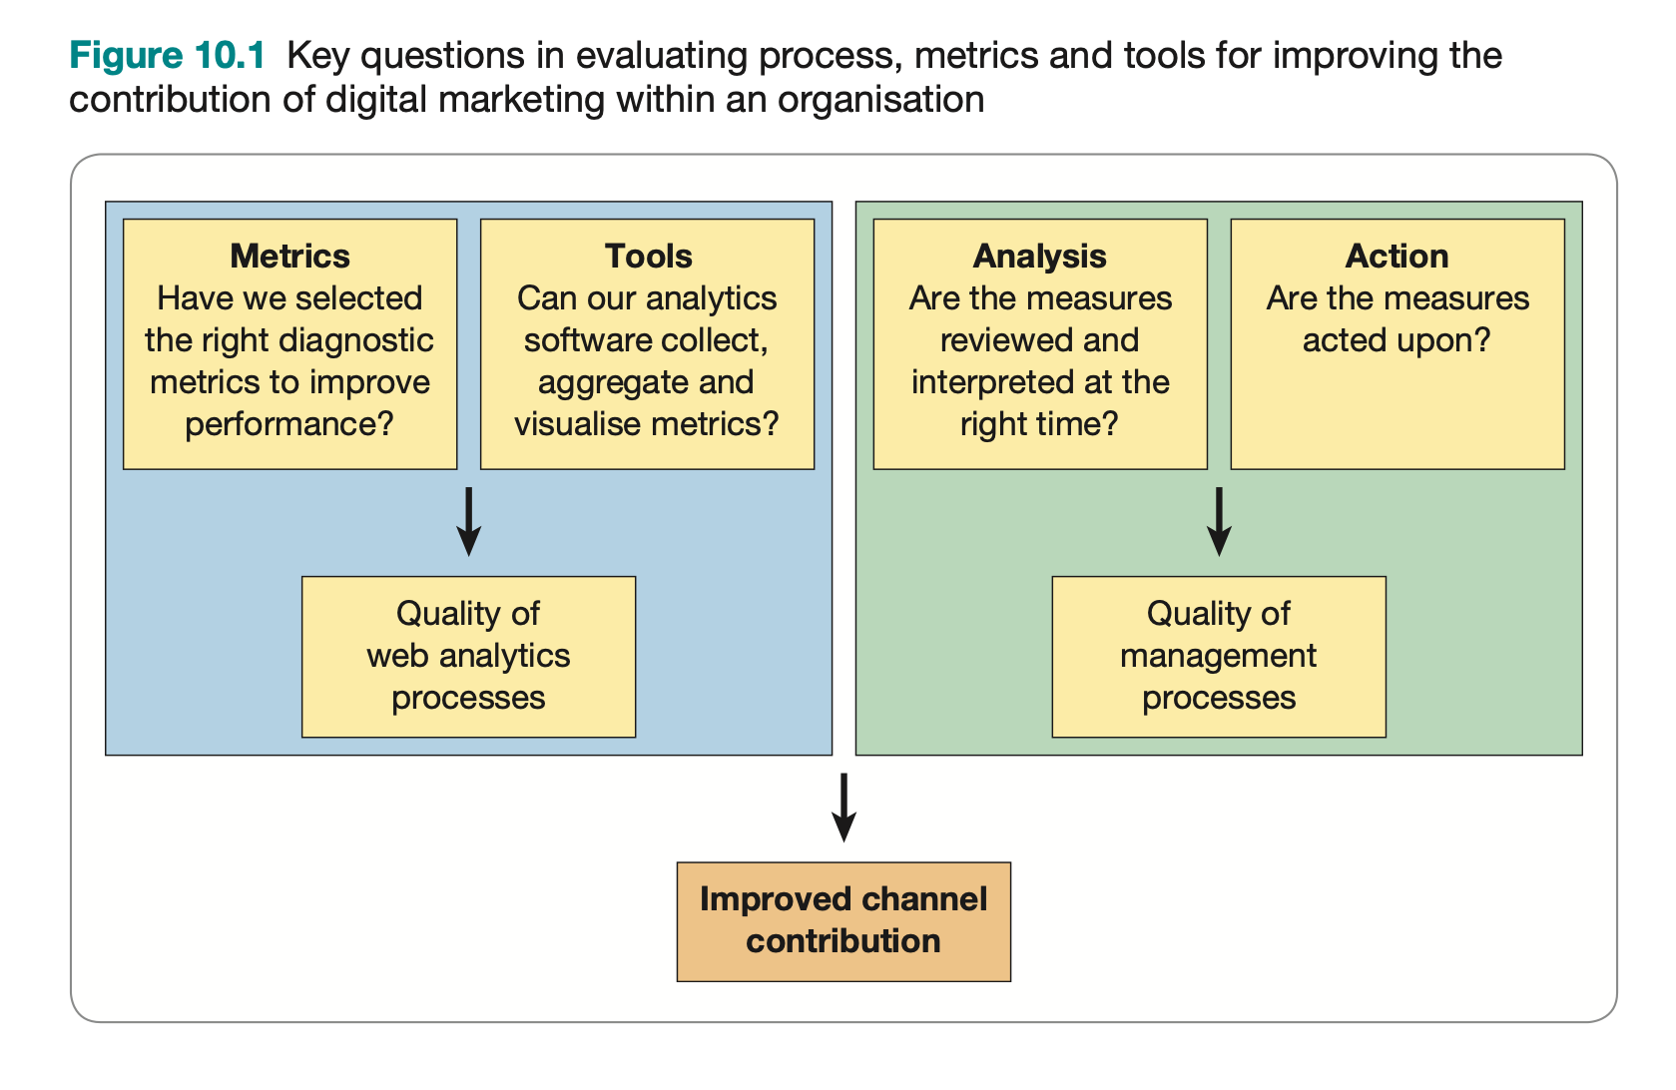
Introduction

Slide 5
Performance management for digital channels
Performance management system: A process used to evaluate and improve the efficiency and effectiveness of an organization and its processes.
Characteristics of PMS for digital channels:
Is the processes and systems intended to monitor and improve the performance of an organization
is based on the study of performance measurement systems
“You can’t manage what you can’t measure” – Napier, CIO of HP, 1960

Slide 6
Performance management for digital channels
Performance measurement system:
is a must-have step for performance management of digital channels - answering the managerial questions in DM
is the process by which metrics are defined, collected, disseminated, and actioned.
Three key elements of a digital marketing measurement system:
performance measurement process
the measurement framework that specifies groups of relevant digital marketing metrics
an assessment of the suitability of tools and techniques for collecting, analysing, disseminating and actioning results.

Slide 7
Performance measurement system (1) Performance measurement process
Performance is measured primarily through information on process effectiveness and efficiency
Effectiveness: Meeting process objectives, delivering the required outputs and outcomes: ‘doing the right thing’.
Efficiency: Minimising resources or time needed to complete a process: ‘doing the thing right’.
A structured performance management process is necessary: the repercussions caused by the lack of it: poor linkage of measures with strategic objectives or absence of objectives; key data not collected; data inaccuracies; data not disseminated or analyzed; or no corrective action
The barriers:
Senior management myopia: performance measurement not seen as a priority, not understood or targeted at the wrong area – reducing costs rather than improving performance.
Unclear responsibilities: for delivering and improving the measurement system.
Resourcing issues: lack of time (perhaps suggesting lack of staff motivation), lack of necessary technology and integrated systems.
Data problems: data overload or of poor quality, limited data for benchmarking: • data access/data silos (22 per cent); incomplete data (16 per cent); inaccurate data (16 per cent); inadequate analytics tools (10 per cent) (Digital Analytics Association, 2017)
Notes:
Analytics challenges reported by digital analysts in the Digital Analytics Association (2017) are most commonly related to data integration and accuracy:
• data access/data silos (22 per cent);
• incomplete data (16 per cent);
• inaccurate data (16 per cent);
• inadequate analytics tools (10 per cent).

Slide 8
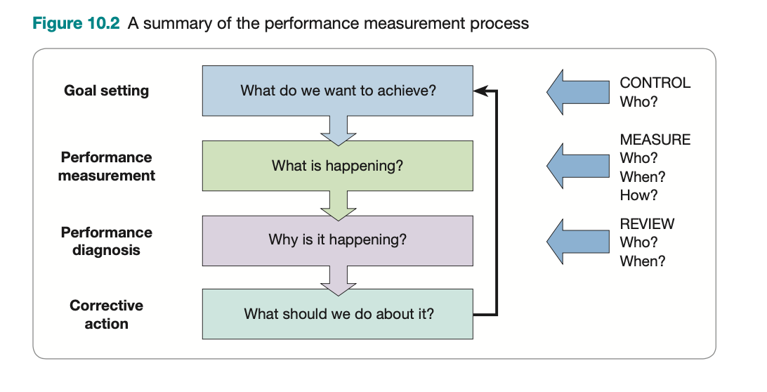
Performance measurement system (1) Performance measurement process
Stage 1 - goal-setting: the aims of the measurement system are defined → taking the strategic digital marketing objectives as input to the measurement system.
Stage 2 - performance measurement: collecting data to determine the different metrics that are part of a measurement framework.
Stage 3 - performance diagnosis: analysis of results to understand the reasons for variance from objectives and selecting marketing solutions to reduce variance.
Stage 4 - corrective action: the implementation of these solutions as regular updates to content, design, ongoing marketing communications and CRO.
After stage 4, the continuous cycle repeats, possibly with modified goals
Notes:
Analytics challenges reported by digital analysts in the Digital Analytics Association (2017) are most commonly related to data integration and accuracy:
• data access/data silos (22 per cent);
• incomplete data (16 per cent);
• inaccurate data (16 per cent);
• inadequate analytics tools (10 per cent).
This chapter focus on stage 1 and 2

Slide 9
Performance measurement system (1) Performance measurement process
Common mistakes in stage 1:
KPIs do not stick to the overall goals of the brand but only care about the amount of interaction
KPIs set that are not synchronized or inconsistent among departments in the organization and align with specific characteristics of brand

Slide 10
Performance measurement system (2) Defining the performance metrics framework
Notes:
Measurement for assessing the effectiveness of digital marketing should assess the contribu- tion of digital marketing at different levels from commercial, strategic issues to communica- tions tactics:
1 Are business objectives defined in the digital marketing strategy being met?
2 Are marketing objectives plans achieved?
3 Are marketing communications objectives achieved?
+ Đo lường theo đóng góp doanh nghiệp: Dựa vào cơ cấu đóng góp vào doanh thu lợi nhuận
+ Đo lường theo kết quả Marketing: Dựa vào khách hàng tiềm năng, những chuyển đổi thành lead
+ Đo lường theo sự hài lòng của khách hàng: Đo lường theo tỷ lệ phản hồi, tần suất khách hàng vào trang, thái độ,...
+ Đo lường theo hành vi của khách hàng: Dựa vào hành động của khách hàng trên trang
+ Đo lường theo theo kết quả xúc tiến: Dựa vào chi phí thu hút và tiếp cận, khả năng chuyển đổi từ email,...
Marketing outcomes
Channel outcomes are traditional marketing objectives such as number of sales, number of leads, conversion rates and targets for customer acquisition and retention, and should be set for digital channels and then compared to other channels.
Key marketing outcomes
Typical marketing outcomes that need to be tracked and reported on using digital analytics and dashboards include:
registration to site or subscriptions to an email newsletter (a new contact or lead);
requests for further information such as a brochure or a request for a call-back from a
customer service representative (a new contact or lead);
responding to a promotion such as an online competition;
an offline (phone or store) lead or sale influenced by a visit to the site;
a sale on-site.
Key measures
Measures that can be reported include:
• Channel contribution (direct and indirect). A widely used method of assessing channel outcomes is to review the conversion rate, which gives an indication of the percentage of site visitors who take a particular outcome. For example: • conversion rate, visitors to purchase = 2 per cent (10,000 visitors, of which 200 make • purchases);
conversion rate, visitors to registration = 5 per cent (10,000 visitors, of which 500 register).

Slide 11
Performance measurement system (3) Tools and techniques for collecting insight, running processes and summarising results
Selecting the most appropriate tools for collecting and reporting metrics that meet requirements: eg. reporting of marketing performance, accuracy, analysis and visualisation tools.
Considering techniques to collect metrics
the collection of site-visitor activity data such as that stored in digital analytics systems such as Google Analytics and Adobe Analytics,
the collection of metrics about outcomes: eg. online sales or email inquiries: traditional marketing research techniques such as questionnaires and focus groups, which collect information on the customer’s experience on the website
Integrating customer data between data sources: challenging as usually different tools for managing digital marketing such as web analytics, digital advertising, email marketing, and customer relationship management (CRM) store data separately.
Customer data platforms (CDPs): to unify this data from different sources – for big company
Notes:
Organisations need to select the most appropriate tools for collecting and reporting metrics that meet requirements, such as reporting of marketing performance, accuracy, analysis and visualisation tools.
Techniques to collect metrics include the collection of site-visitor activity data such as that stored in digital analytics systems such as Google Analytics and Adobe Analytics, and the collection of metrics about outcomes such as online sales or email enquiries and tradi- tional marketing research techniques such as questionnaires and focus groups, which collect information on the customer’s experience on the website. Integration of customer data between data sources is a challenge, since often different tools for managing digital market- ing such as web analytics, digital advertising, email marketing and customer relationship management (CRM) store data separately. Larger organisations invest in customer data platforms (CDPs) to unify this data from different sources.

Slide 12
Performance measurement system (3) Tools and techniques for collecting insight, running processes and summarising results
Using Google Analytics to evaluate and improve DM Considering techniques to collect metrics
Marketing research using the internet and digital media:
Website feedback tools.
Site-user intent-satisfaction surveys.
Crowdsourcing voice-of-customer and product-opinion software.
Simple page or concept feedback tools.
General online survey tools. Freemium tools such as SurveyMonkeyTM (www. surveymonkey.com) and CrowdsignalTM (www.crowdsignal.com) enable companies to survey their audience at a low cost.
Others techniques: focus group, mystery shopper
Notes:
Website feedback tools. These provide a permanent facility for customers to give feed- back using prompts on every page. They are run continuously to enable continuous feedback, including ratings on page content and also products and services. Structured Net Promoter Score (NPS) surveys can also be used regularly to gain a benchmark score
comparing promoters against detractors.
2 Site-user intent-satisfaction surveys. These tools measure the gap between what the user
had hoped to do on the site and what they actually achieved. We give an example in
Chapter 7 that covers four questions to assess site effectiveness.
3 Crowdsourcing voice-of-customer and product-opinion software. These are broader than
web feedback, enabling customers to comment about customer satisfaction and potential
new services.
4 Simple page or concept feedback tools. A form of crowdsourcing, these tools give
feedback from an online panel about page layout, messaging or services. Tools such as UserTesting and UserZoom provide video feedback on site prototypes through repre- sentative customers completing common tasks.
5 General online survey tools. Freemium tools such as SurveyMonkeyTM (www. surveymonkey.com) and CrowdsignalTM (www.crowdsignal.com) enable companies to survey their audience at a low cost.

Slide 13
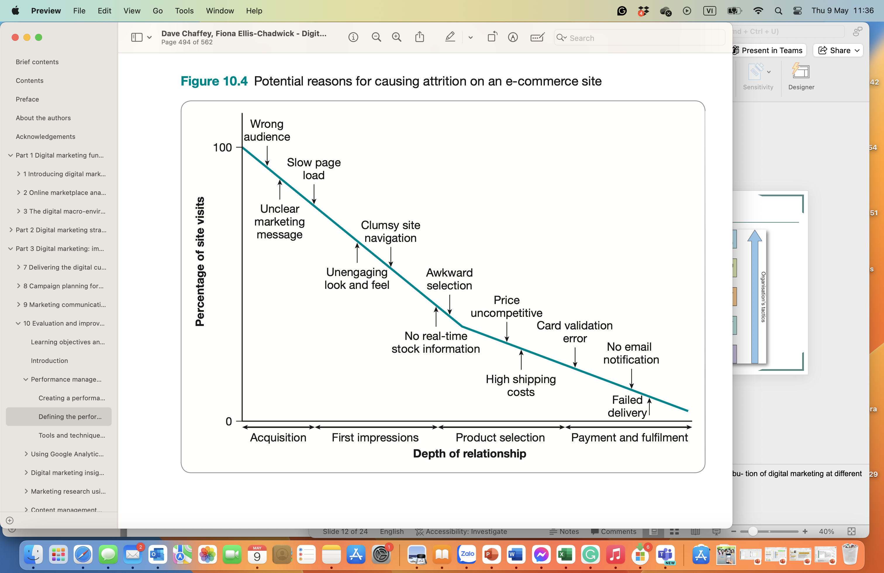
Performance measurement system Performance diagnosis + corrective action

Slide 14
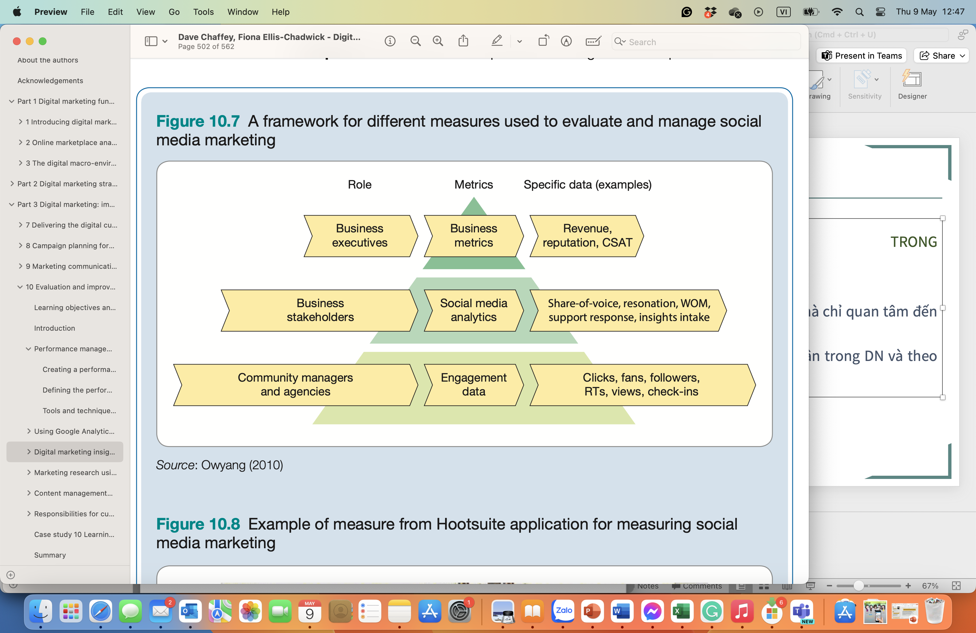
Performance measurement system Performance diagnosis + corrective action

Slide 15
Content management process
Content management process:
is part of the process of continuous improvement in online marketing,
a clearly defined process for making changes to the online presence of a company.
Tasks involved in the maintenance process:
Write. This stage involves writing the marketing copy and, if necessary, designing the layout of copy and associated images.
Review. An independent review of the copy is necessary to check for errors before a document is published. Depending on the size of organization, review may be necessary by one person or several people covering different aspects of content quality such as corporate image, copy-editing text to identify grammatical errors, marketing copy, branding and legality.
Correct. This stage is straightforward and involves updates necessary as a result of stage 2.
Publish (to test environment). The publication stage involves putting the corrected copy on a web page that can be checked further. This will be in a test environment that can only be viewed from inside the company.
Test. Before the completed web page is made available over the World Wide Web a final test will be required for technical issues, such as whether the page loads successfully on different browsers.
Publish (to live environment). Once the material has been reviewed and tested and is signed off as satisfactory, it will be published to the main website and will be accessible to all customers.
How often should content be updated?
Notes:
Outsource: agent, freelancer

Slide 16
Responsibilities for customer experience and site management
The questions to ask are:
(1) Who owns the process?: the overall process for agreeing on new site content and updating the site.
the large company: those within the marketing department and the site developers – which may be an external agency or the IT department.
The process will specify responsibilities for different aspects of site management and detail the sequence in which tasks occur for updating the site.
(2) Who owns the content?
distribute the responsibility for owning and developing different sections of the site to the people in an organisation who have the best skills and knowledge to develop that content.
develop guidelines and standards that help ensure that the site has a coherent ‘feel’ and appearance
(3) Who owns the format?
The key aim is consistency of messaging and format across the whole website.
Defining a clear format or site design templates for the different page or content types means that the quality of the site and customer experience will be better
(4) Who owns the technology?
Content management system (CMS): An online service or software tool for creating, editing, and updating online content assets such as text and visual content forming web or mobile app pages.
Notes:
CMSs provide these facilities:
Page creation and editing: an interface for adding and editing page content.
Information architechture: the design and maintenance of content structure (sub-
components, templates, etc.), web page structure and website structure.
Link management: the maintenance of internal and external links through content
change and the elimination of dead links.
Search engine visibility: modification of page metadata (described at the start of Chap-
ter 9) so that relevant titles and content snippets are served in search engines.
Input and syndication: the loading (spidering) of externally originated content and the
aggregation and dissemination of content from a variety of sources.
Versioning: controlling which edition of a page, page element or the whole site is pub- lished. Typically this will be the most recent, but previous editions should be archived and it should be possible to roll back to a previous version at the page, page element or
site level. Security and access control: different permissions can be assigned to different roles of users and some content may only be available through log-in details. In these cases, the CMS maintains a list of users. This facility is useful when a company needs to use the same CMS for an intranet, extranet or public internet site that may have different levels
of permission. Publication workflow: content destined for a website needs to pass through a publication process to move it from the management environment to the live delivery environment. The process may involve tasks such as format conversion (e.g. to PDF), rendering to HTML, editorial authorisation and the construction of composite documents in real
time (personalisation and selective dissemination). Tracking and monitoring: providing logs and statistical analysis of use to provide perfor- mance measures, tune the content according to demand and protect against misuse.

Slide 17
Responsibilities for customer experience and site management
Notes:
CMSs provide these facilities:
Page creation and editing: an interface for adding and editing page content.
Information architechture: the design and maintenance of content structure (sub-
components, templates, etc.), web page structure and website structure.
Link management: the maintenance of internal and external links through content
change and the elimination of dead links.
Search engine visibility: modification of page metadata (described at the start of Chap-
ter 9) so that relevant titles and content snippets are served in search engines.
Input and syndication: the loading (spidering) of externally originated content and the
aggregation and dissemination of content from a variety of sources.
Versioning: controlling which edition of a page, page element or the whole site is pub- lished. Typically this will be the most recent, but previous editions should be archived and it should be possible to roll back to a previous version at the page, page element or
site level. Security and access control: different permissions can be assigned to different roles of users and some content may only be available through log-in details. In these cases, the CMS maintains a list of users. This facility is useful when a company needs to use the same CMS for an intranet, extranet or public internet site that may have different levels
of permission. Publication workflow: content destined for a website needs to pass through a publication process to move it from the management environment to the live delivery environment. The process may involve tasks such as format conversion (e.g. to PDF), rendering to HTML, editorial authorisation and the construction of composite documents in real
time (personalisation and selective dissemination). Tracking and monitoring: providing logs and statistical analysis of use to provide perfor- mance measures, tune the content according to demand and protect against misuse.

Slide 18
Chapter reference
Chaffey D. & Ellis-Chadwick F. (2022). Digital marketing - Strategy, Implementation and Practice (8th edition), chapter 10. Pearson. UK

Slide 19


